Slide 1

N13 Entertainment
Technical Documentation for the Web Application
By
Nikheel Manhar Asodia

Slide 2
Download the zipped folder (AsodiaNikheel).
Remember the path of where you have extracted the folder.
Next, make sure your computer has Visual Studio Code, NodeJS, and MongoDB installed.
Open the file in Visual Studio Code.
The directory should look like the image on your right.

Slide 3
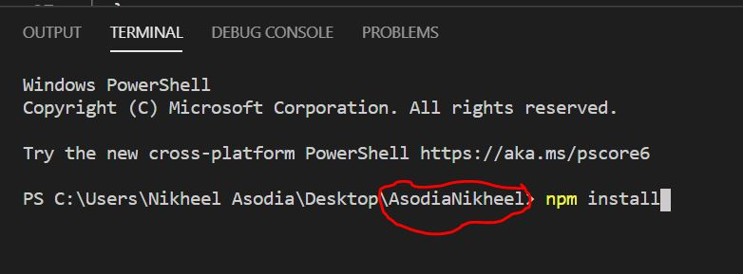
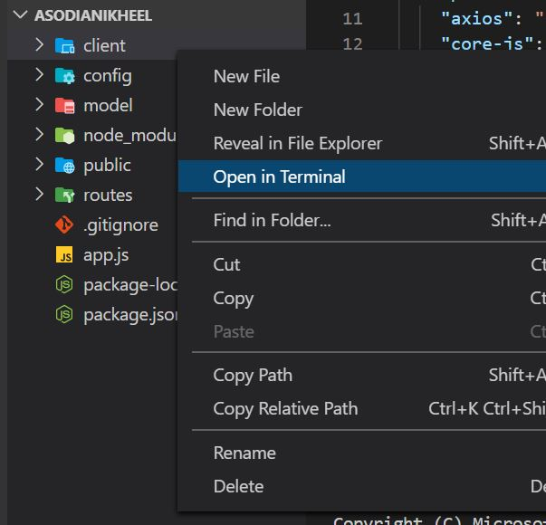
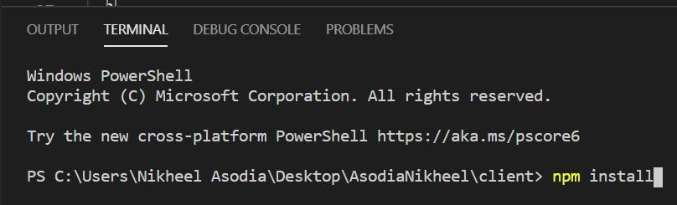
Open the root folder in terminal.
Run the command “npm install”.
Thereafter, right click on the client folder and run it on terminal.
Now enter the command “npm install”.
Both the folders should now have json files with each folders dependencies.

Slide 4
Open command prompt to add db data:
Mongo
show dbs
Use New
New.sports.insert({name:’Basketball’})
New.sports.insert({name:’Baseball’})
New.sports.insert({name:’Football’})
New.sports.insert({name:’boxing’})
New.sports.insert({name:’Soccer’})
New.sports.insert({name:’Cricket’})
New.sports.insert({name:’Golf’})

Slide 5
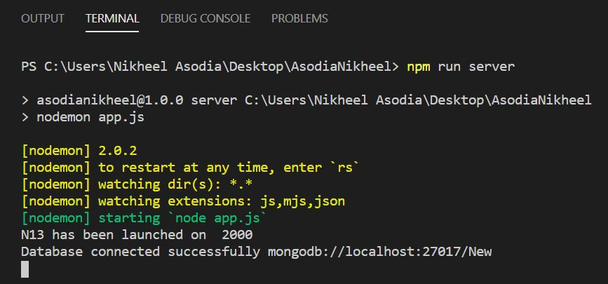
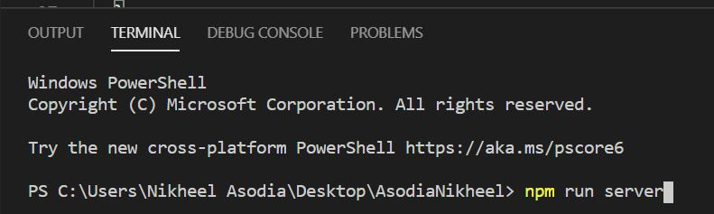
Open the root folder in a new terminal.
Run the command “npm run server”.
The server should be running.

Slide 6
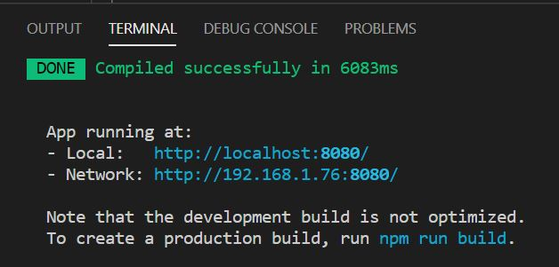
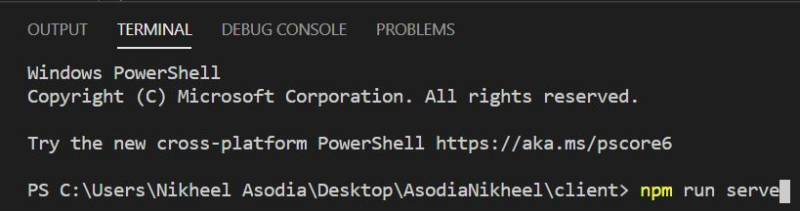
Now right click on the client folder again and open it in the terminal.
Next, run the command npm run serve.
Now both the server side and the client side are up and running.

Slide 7
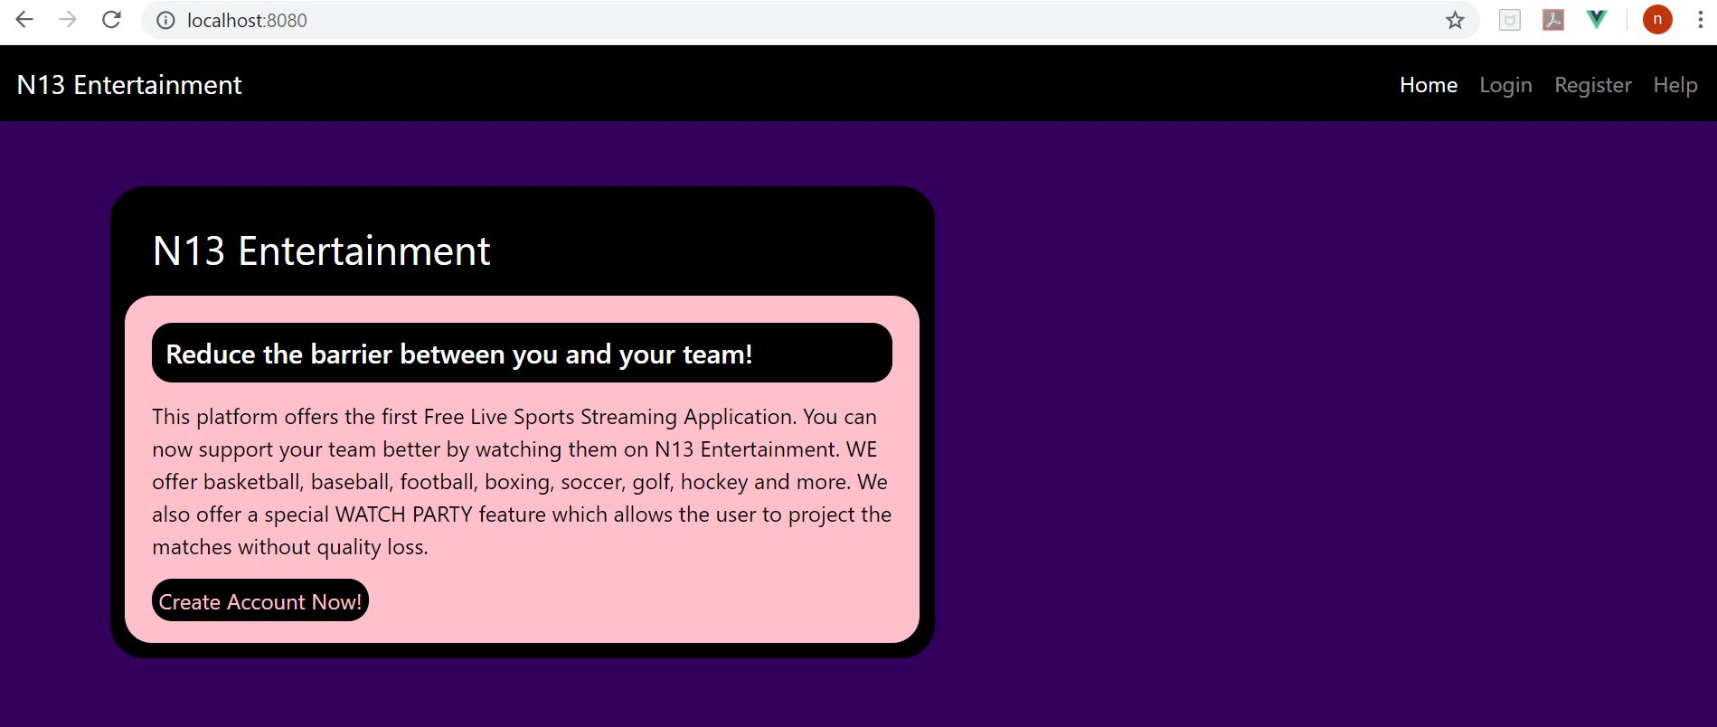
The website should be good to go

Slide 8
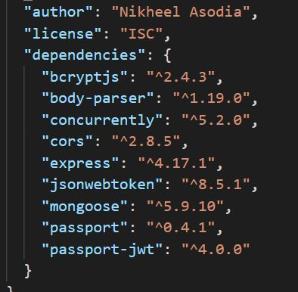
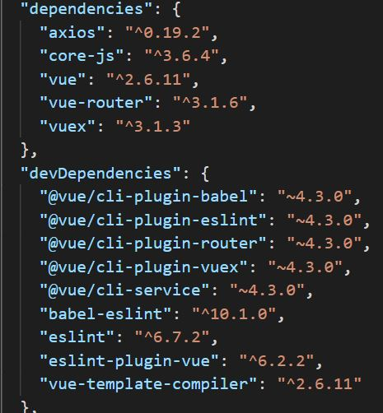
Further dependency information for both the folders
Root Folder Dependencies
Client Folder Dependencies

